Slide 1
Data Science Meets Deep Learning
Dr. Zhao Rui

Slide 2


Dr. Zhao Rui
Quantitative Researcher
Adjunct Lecturer at NUS
Former Data Scientist at Shopee
Education
Ph.D EEE NTU 2017
B. S EE Southeast University

Slide 3
Overview
5-Weeks Program Focusing on Deep Learning With Applications in NLP
Week 1: Introduction to NLP and Deep learning and Logistic Regression
Week 2: Neural Network
Week 3: Word Embeddings
Week 4: Language model and RNN
Week 5: Sentiment analysis and CNN

Slide 4


Course Logistics
Instructors
Dr. Zhao Rui Paul Yuan
Time: Sat, 9:00 am - 12:00 am
Material link: To be announced tonight.

Slide 5
Agenda
Introduction to Natural Language Processing
Introduction to Deep Learning
Deep learning and NLP
Logistic vs Softmax vs Neural Network
Hands-On

Slide 6

What is Natural Language Processing(NLP)?
Natural Language Processing: a field with three sub-topics:
Computer Science
Artificial intelligence
Linguistics
NLP enables computers to understand and process human languages.
One definition of AI-complete is perfect language understanding.

Slide 7
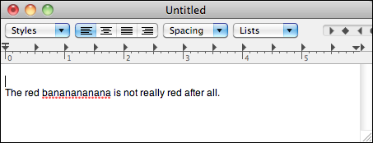
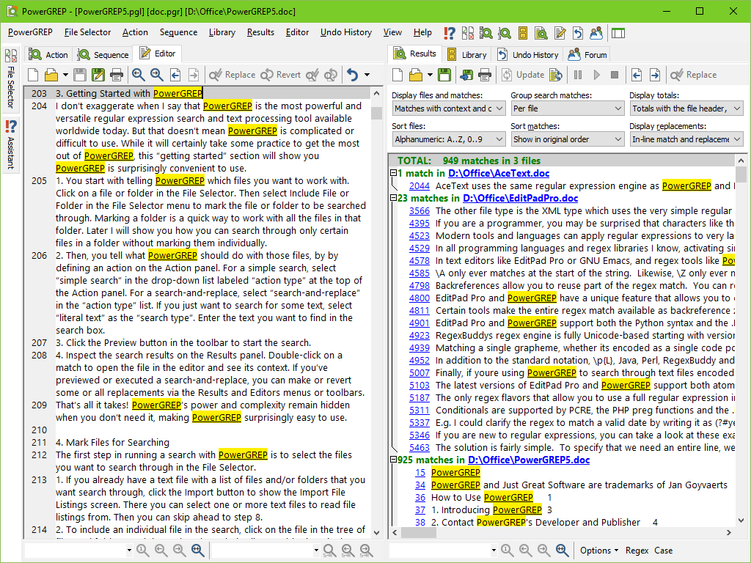
Easy NLP Tasks
Spell Checking
Keyword search

Slide 8
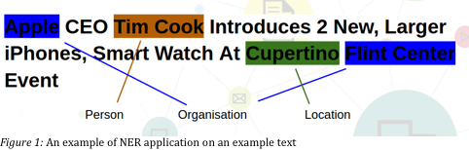
Medium-Level NLP Tasks
Name Entity Recognition
Convert unstructured text into a well structured format
I

Slide 9
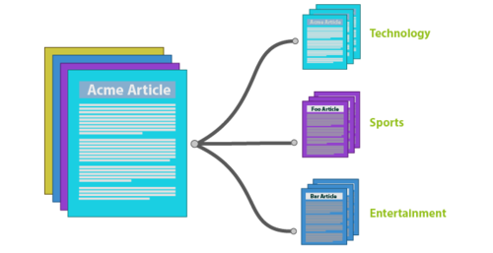
Medium-Level NLP Tasks
Topic Classification
Assign topic into each document/piece of text
I

Slide 10
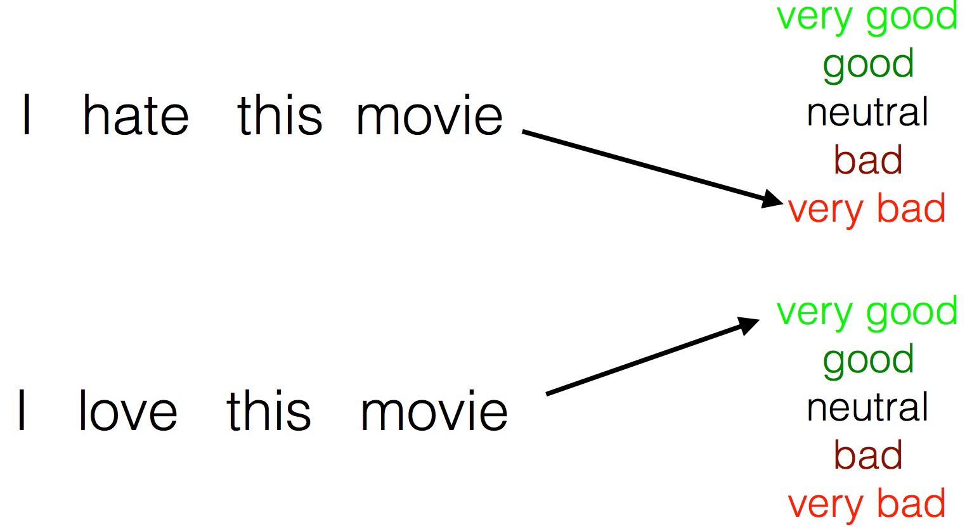
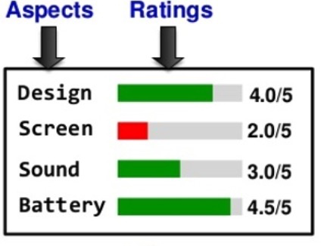
Hard NLP Tasks
Sentiment Analysis
Aspect-based Sentiment Analysis
Analyze opinions/sentiment behind text
I

Slide 11
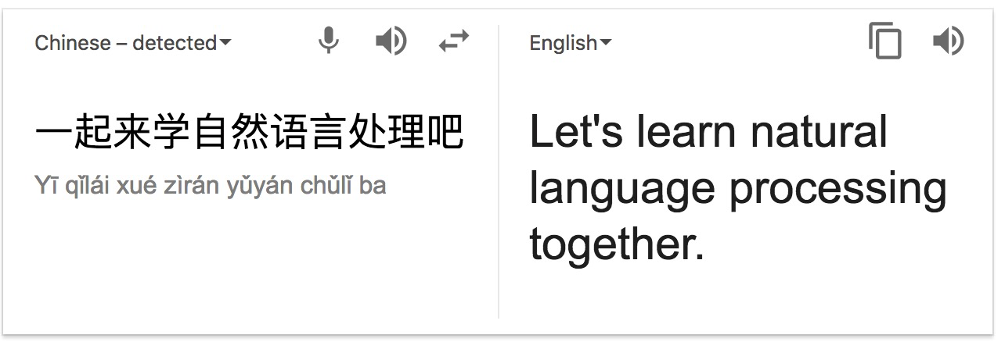
Hard NLP Tasks
Machine Translation
Rule-based, Phrase-based and neural network based
I

Slide 12
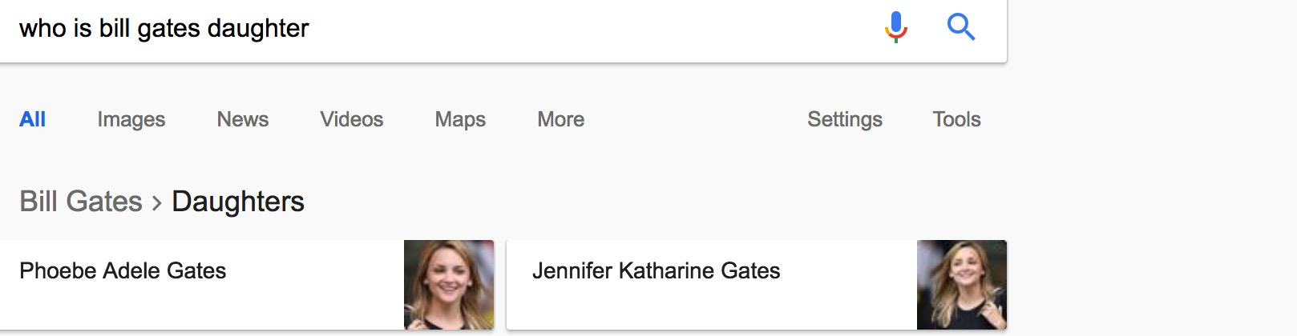
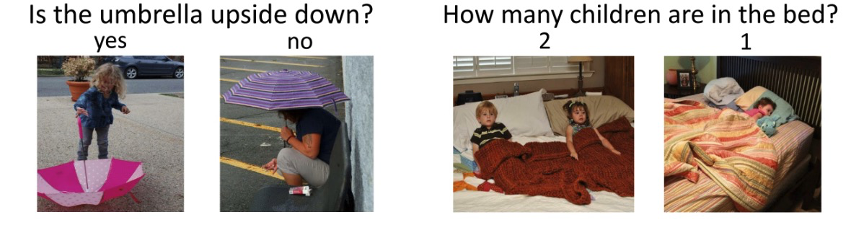
Hard NLP Tasks
Question Answering
Visual Question Answering
answer questions in natural language. For chatbot, For semantic search
I

Slide 13
NLP in Industries
NLP in Finance
Assess the sentiment of news for trading
Automatic report summarization and generation
Due diligence screening
2. NLP in E-commerce
Semantic Search
Chatbot
Name entity recognition
Machine Translation

Slide 14
NLP Is Very Challenging
Ambiguity of Language
Lexical Ambiguity: bank
Syntactic Ambiguity: I heard his cell phone in my office
Semantic Ambiguity:
2. Data Variation
We have ImageNet, while we do not have such huge labelled volume text data
3. Complexity in representation, learning and using linguistic/situational/word/visual knowledge

Slide 15

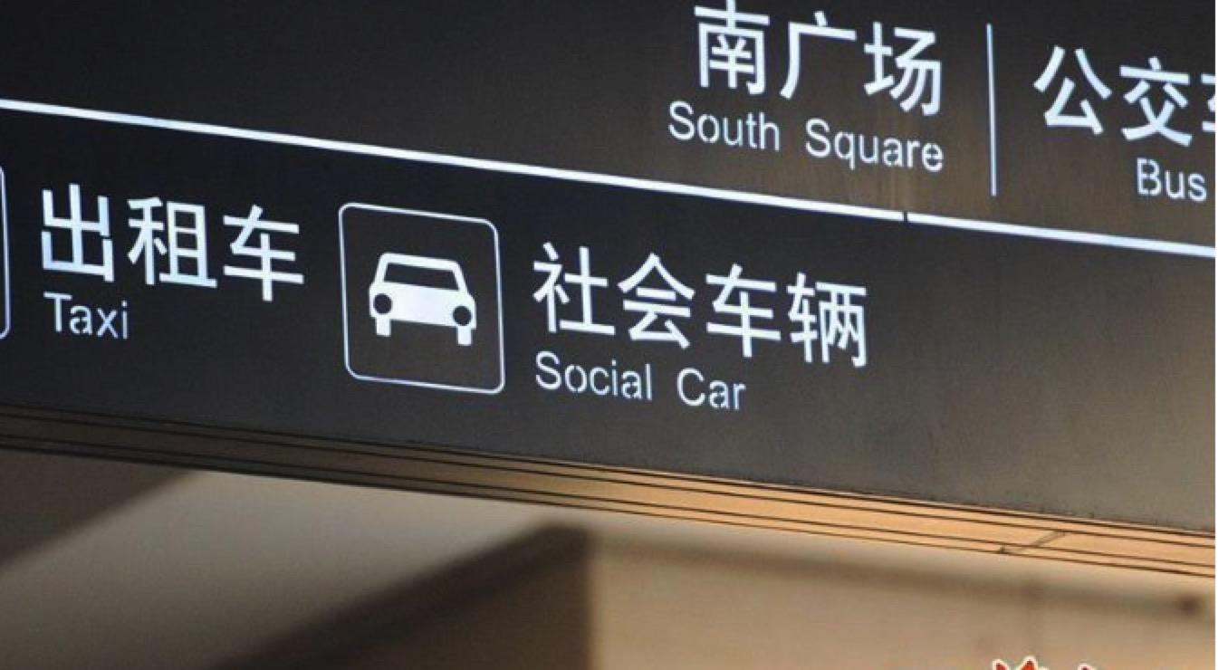
Some Funny Machine Translation Examples

Slide 16
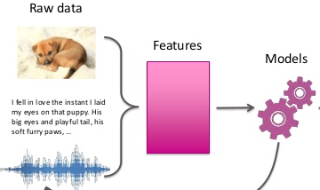
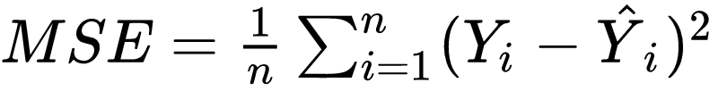
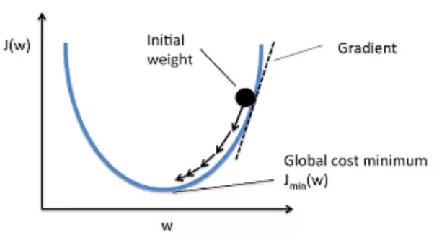
Machine Learning
Machine Learning can be decomposed into three components:
Representation (Model and Data Level)
Evaluation (Loss Function/ Target Function)
Optimization: How to search representation to obtain better evaluation
2. NLP based on machine learning do not require intensive human labor
Notes:
Representation is the landscape of possible models, the playing field allowed by a given representation. For example, 3-layer feedforward neural networks (or computational graphs) form one type of representation, while support vector machines with RBF kernels form another.
Evaluation is essentially how you judge or prefer one model vs. another; it’s what you might have seen as a utility function, loss function, scoring function, orfitness function in other contexts. Think of this as the height of the landscape for each given model, with lower areas being more preferable/desirable than higher areas (without loss of generality). Mean squared error (of a model’s output vs. the data output) or likelihood (the estimated probability of a model given the observed data) are examples of different evaluation functions that will imply somewhat different heights at each point on a single landscape.
Optimization, finally, is how you search the space of represented models to obtain better evaluations. This is the way you expect to traverse the landscape to find the promised land of ideal models; the strategy of getting to where you want to go. Stochastic gradient descent and genetic algorithms are two (very) different ways of optimizing a model class. Note that once you provide a trained model, it’s quite possible that you may no longer be able to recover exactly how it was optimized. Just because I can see you standing in the pit doesn’t mean I know how you got there.

Slide 17
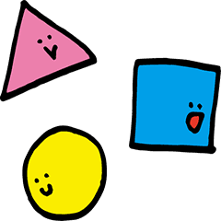
Representation Learning
Given a task: how to classify these following shapes:
2. Our system should work as:
Input: Image
Representation: Number of corners.
Model: Fed with representation and based on mathematical models or rules to make prediction
3. Designing features is a complex process, which require a deep domain expertise.
4. Deep learning is the method which tries to learn features by the model itself.
Notes:
So, in this simple example we found and chose the transformation to get a better representation by hand. But if we create a system, a program that can search for different representations (in this case a coordinate change), and then find a way of calculating the percentage of categories being classified correctly with this new approach, in that moment we are doing Machine Learning.
This is something very important to have in mind, deep learning is representation learning using different kinds of neural networks and optimize the hyperparameters of the net to get (learn)the best representation for our data.

Slide 18
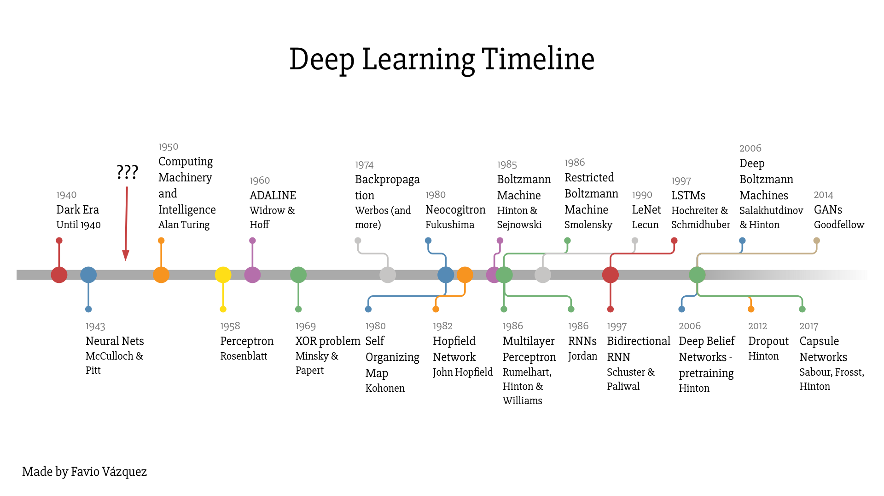
Deep Learning Timeline

Slide 19
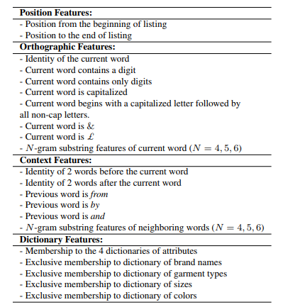
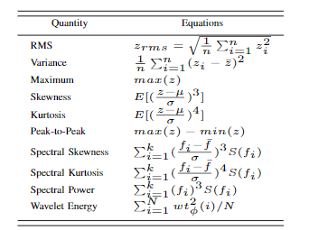
Deep Learning
Deep learning is a subfield of machine learning
Most machine learning methods work well because of high-quality feature engineering. (1) SIFT or HOG features for images
(2) MFCC or LPC features for speech
(3) Features about words parts (suffix, capitalized)
Optimization in conventional machine learning only focus on model-level to improve evaluation.
Notes:
http://www.aclweb.org/anthology/D11-1144

Slide 20

What is Deep Learning?
DL focus on representation learning instead of feature engineering
Representation learning attempts to automatically learn good features or representation;
It will learn multiple levels of representation;
From “raw” inputs x;
Neural networks are the currently successful method for deep learning
Notes:
Representation is the landscape of possible models, the playing field allowed by a given representation. For example, 3-layer feedforward neural networks (or computational graphs) form one type of representation, while support vector machines with RBF kernels form another.
Evaluation is essentially how you judge or prefer one model vs. another; it’s what you might have seen as a utility function, loss function, scoring function, orfitness function in other contexts. Think of this as the height of the landscape for each given model, with lower areas being more preferable/desirable than higher areas (without loss of generality). Mean squared error (of a model’s output vs. the data output) or likelihood (the estimated probability of a model given the observed data) are examples of different evaluation functions that will imply somewhat different heights at each point on a single landscape.
Optimization, finally, is how you search the space of represented models to obtain better evaluations. This is the way you expect to traverse the landscape to find the promised land of ideal models; the strategy of getting to where you want to go. Stochastic gradient descent and genetic algorithms are two (very) different ways of optimizing a model class. Note that once you provide a trained model, it’s quite possible that you may no longer be able to recover exactly how it was optimized. Just because I can see you standing in the pit doesn’t mean I know how you got there.

Slide 21
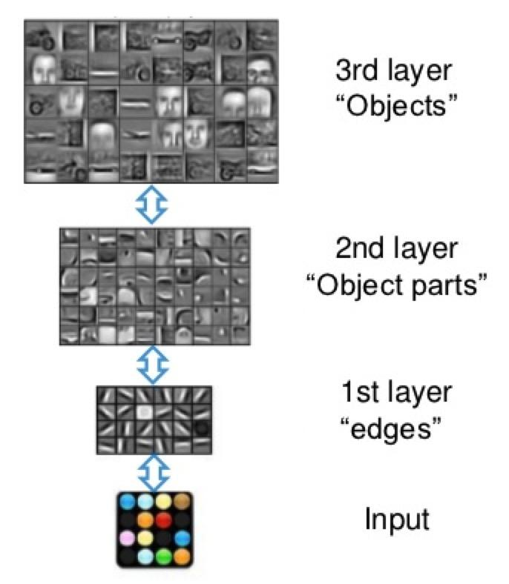
Learning Feature Hierarchy In Deep Learning
Representation Learning
Deep architectures can be representationally efficient
Natural progression from low to high level structures
Can share the lower-level representations for multiple tasks.
Notes:
Representation is the landscape of possible models, the playing field allowed by a given representation. For example, 3-layer feedforward neural networks (or computational graphs) form one type of representation, while support vector machines with RBF kernels form another.
Evaluation is essentially how you judge or prefer one model vs. another; it’s what you might have seen as a utility function, loss function, scoring function, orfitness function in other contexts. Think of this as the height of the landscape for each given model, with lower areas being more preferable/desirable than higher areas (without loss of generality). Mean squared error (of a model’s output vs. the data output) or likelihood (the estimated probability of a model given the observed data) are examples of different evaluation functions that will imply somewhat different heights at each point on a single landscape.
Optimization, finally, is how you search the space of represented models to obtain better evaluations. This is the way you expect to traverse the landscape to find the promised land of ideal models; the strategy of getting to where you want to go. Stochastic gradient descent and genetic algorithms are two (very) different ways of optimizing a model class. Note that once you provide a trained model, it’s quite possible that you may no longer be able to recover exactly how it was optimized. Just because I can see you standing in the pit doesn’t mean I know how you got there.

Slide 22
Deep Learning’s Tasks
Deep Learning are well suitable for high-dimensional and unstructured data
Examples: images, videos, speech and text.
Deep Learning has achieved state-of-arts results over the following tasks
Challenging prediction problems
Generative models of data

Slide 23
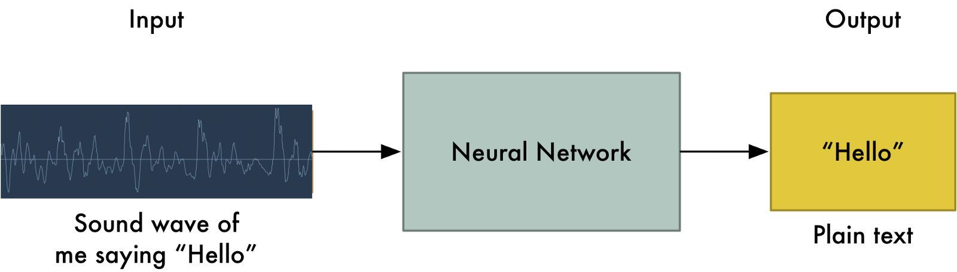
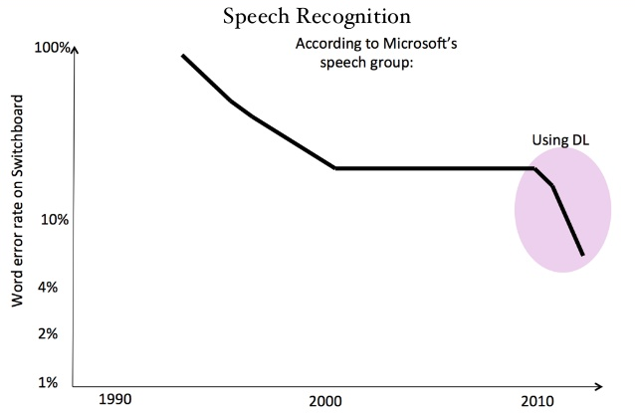
Deep Learning for Speech
The first real-world tasks addressed by deep learning is speech recognition

Slide 24
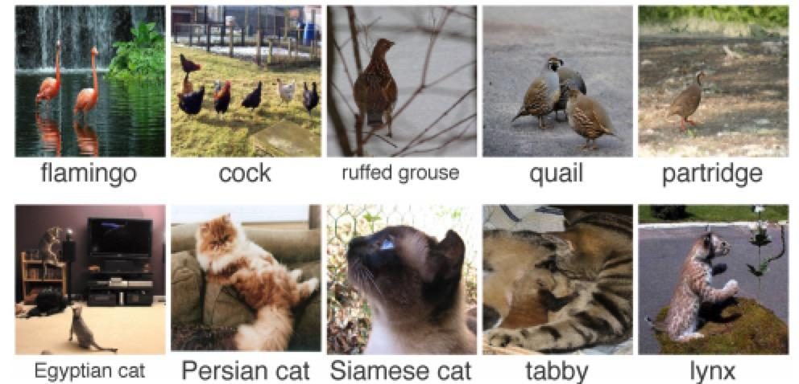
Deep Learning for Computer Vision
Computer vision may be the most well-known breakthrough of DL.
ImageNet Classification with Deep Convolutional Neural Networks.

Slide 25
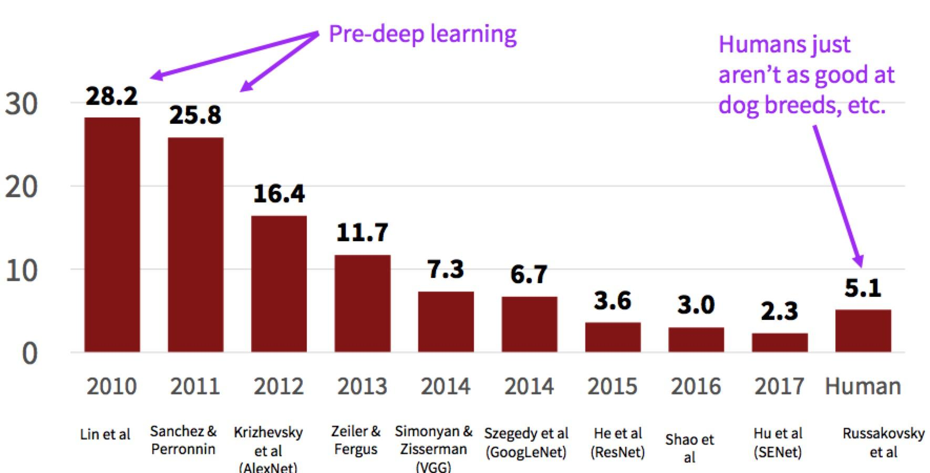
ImageNet Scoreboard

Slide 26
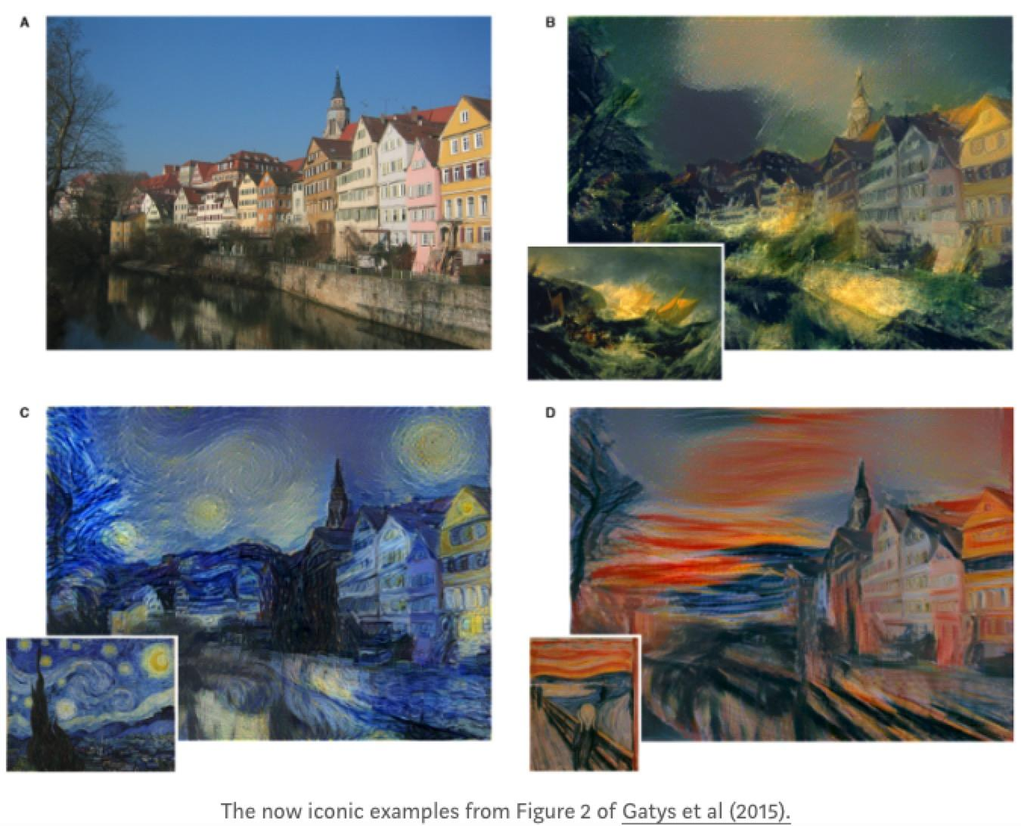
Deep Learning For Arts
Style transfer based on DL: use one image to stylize another.
Use CNN to extract representation of style and content CNN. And apply another CNN to keep the small-scale features of the style image while keep the large-scale features of the Source image.

Slide 27
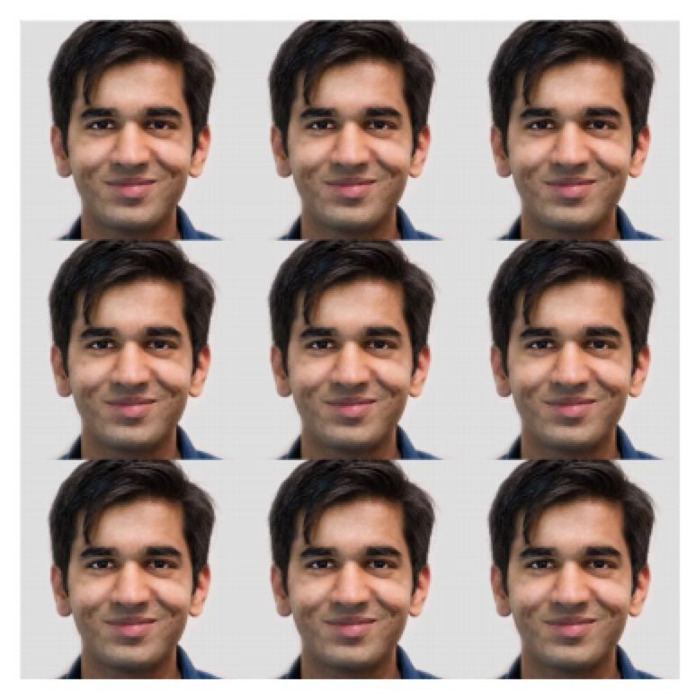
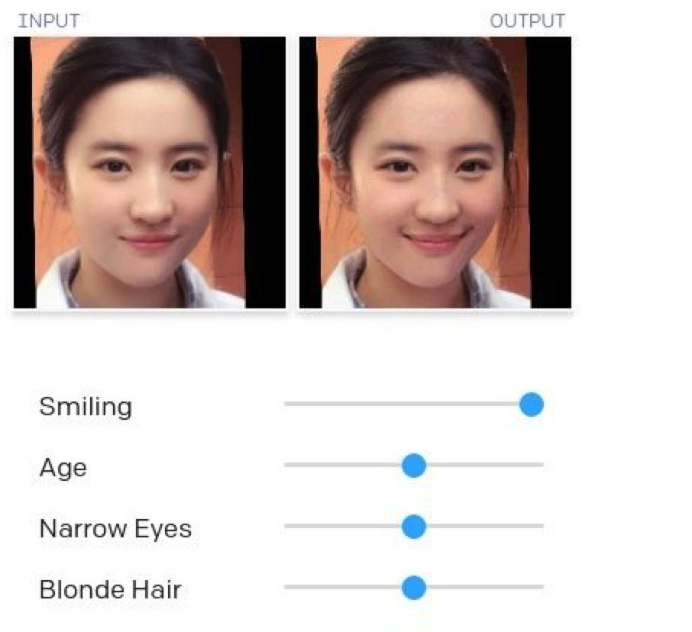
Deep Learning For Data Generation
Glow, a reversible generative model using invertible 1*1 convolutions, learns a latent space where certain directions capture attributes like age, hair color, and so on.
(2018_Kingma & Dhariwal)

Slide 28
Why is Deep Learning Powerful Now?
Feature engineering require high-level expert knowledge, which are easily over-specified and incomplete.
Large amounts of training data
Modern multi-core CPUs/GPUs
Better deep learning ‘tricks’ such as regularization, optimization, transfer etc.
Better context-modeling due to less independence assumptions
Effective method for end-to-end system optimization.
Notes:
Learned Features are easy to adapt, fast to learn • Deep learning provides a flexible framework for learning to represent information from the world

Slide 29
Deep Learning Meets NLP
Deep learning methods are used to solve NLP problems with a focus on representation learning, i.e. better Vectors.
Based on different levels of natural language, DL has achieved several big improvements:
Linguistic Levels: word, syntax
Intermediate tasks/tools: entities, parsing, parts-of-speech
Full applications: sentiment analysis, machine translation, question answering

Slide 30
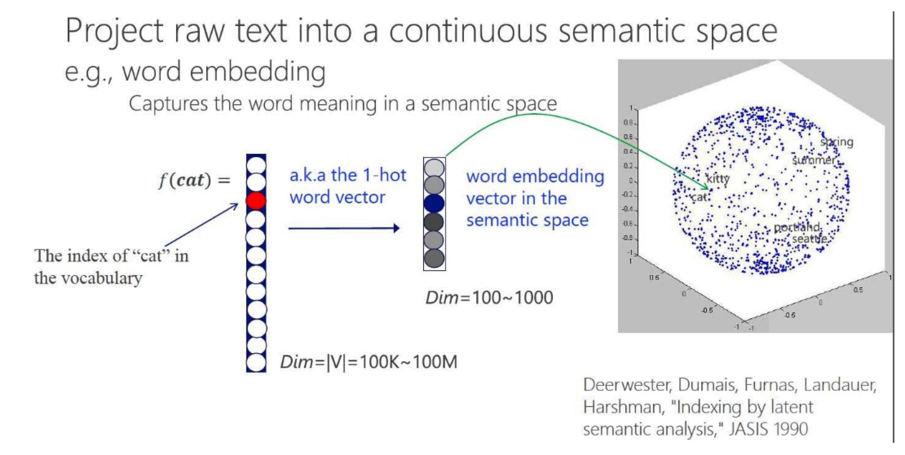
Word Vector
Each word is represented as a dense and real-valued vector in a low dimensional space.
This is a graphic from (He. et al, 2014)

Slide 31
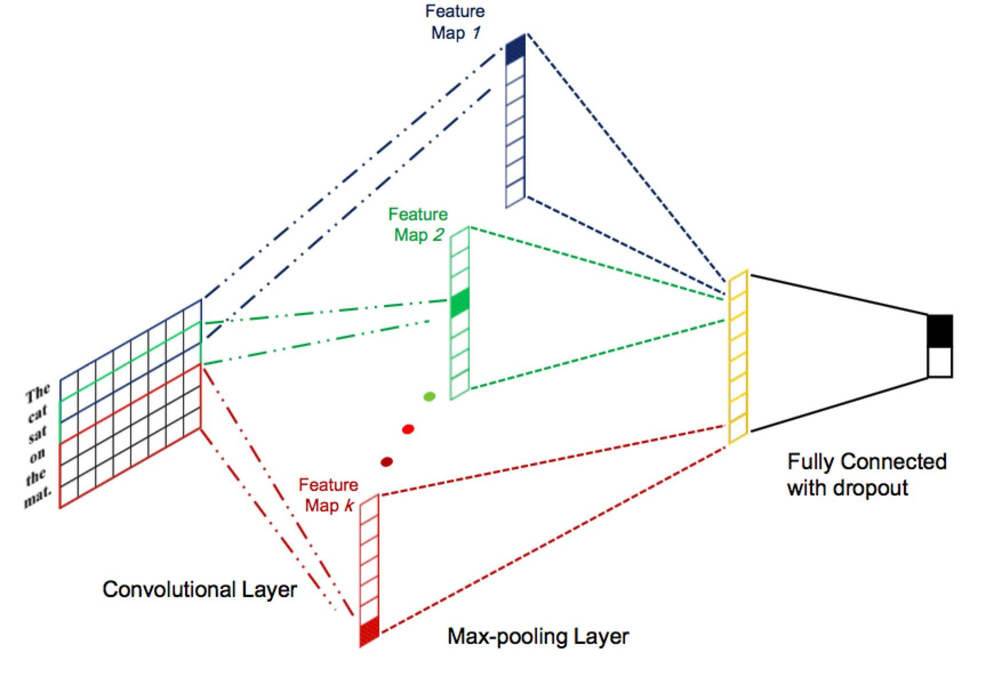
Semantic Vector
Semantic behind sentences/documents can be encoded as vectors.
Deep learning is able to do the composition as:
Every word is a vector
A neural network (CNN or RNN) do the composition

Slide 32
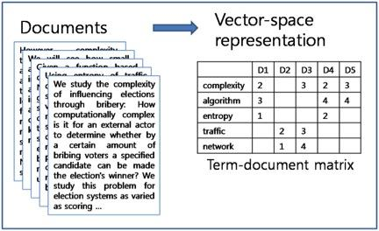
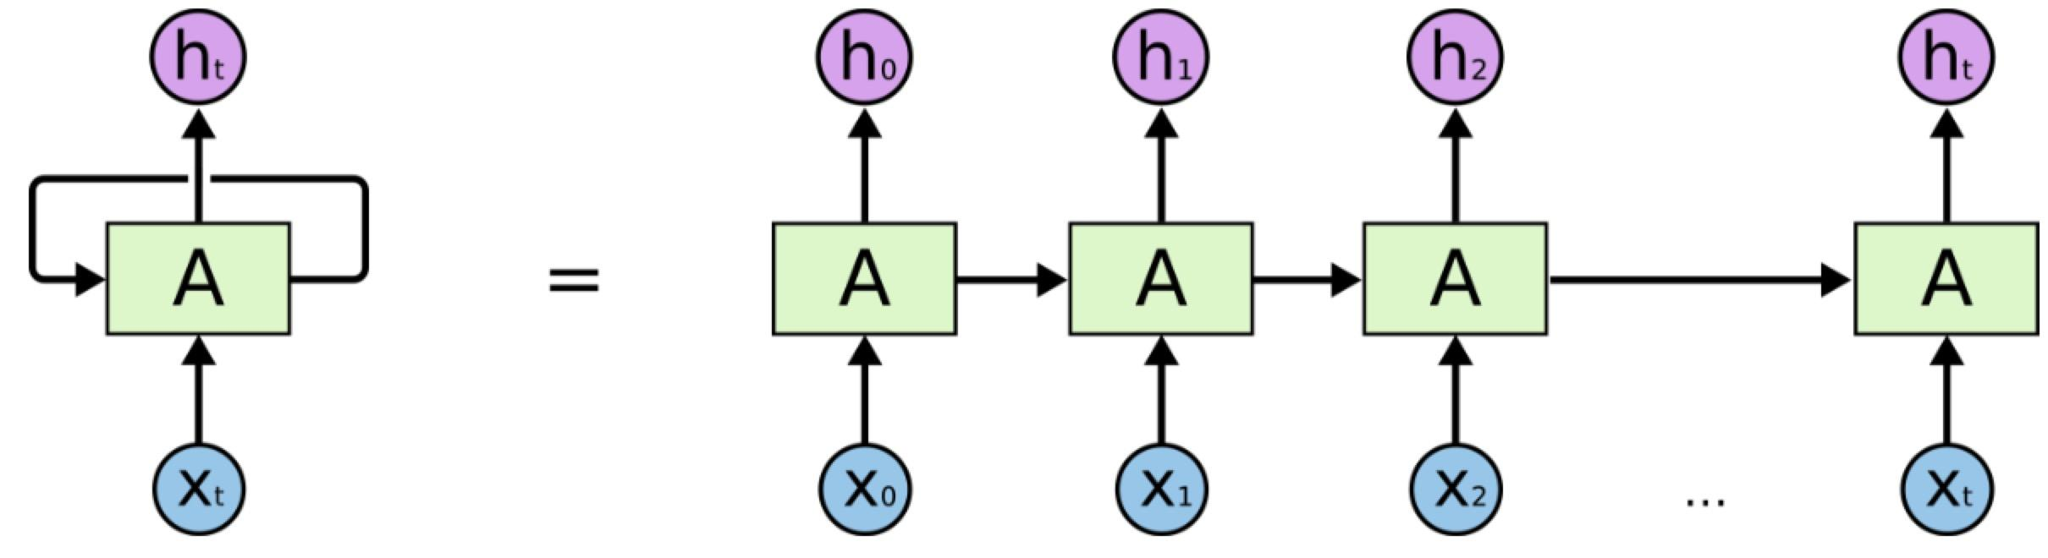
Sentiment Analysis
Traditional approaches:
Bag-of-words are used and fed into classifiers.
Sentiment word list are used, which contain positive and negative words.
Deep learning models:
Same semantic vector models
Word vectors or even char vectors as input
Notes:
Need hand-desgined features to capture negation

Slide 33
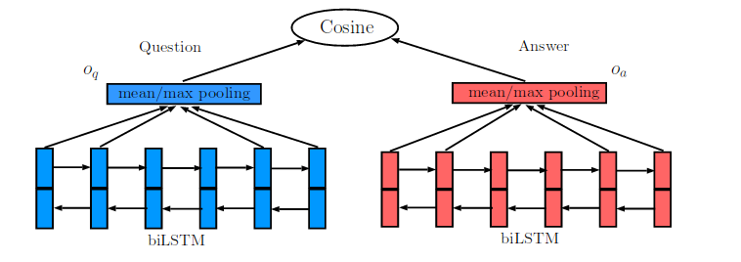
Question Answering
Traditional approaches:
Hand-craft rules are designed to capture word and other knowledge.
Regular expression used a lot
Deep learning approaches:
Same semantic vector models
Questions and answers are projected into the same vector space.
From Tan et al 2016
Notes:
Need hand-desgined features to capture negation

Slide 34
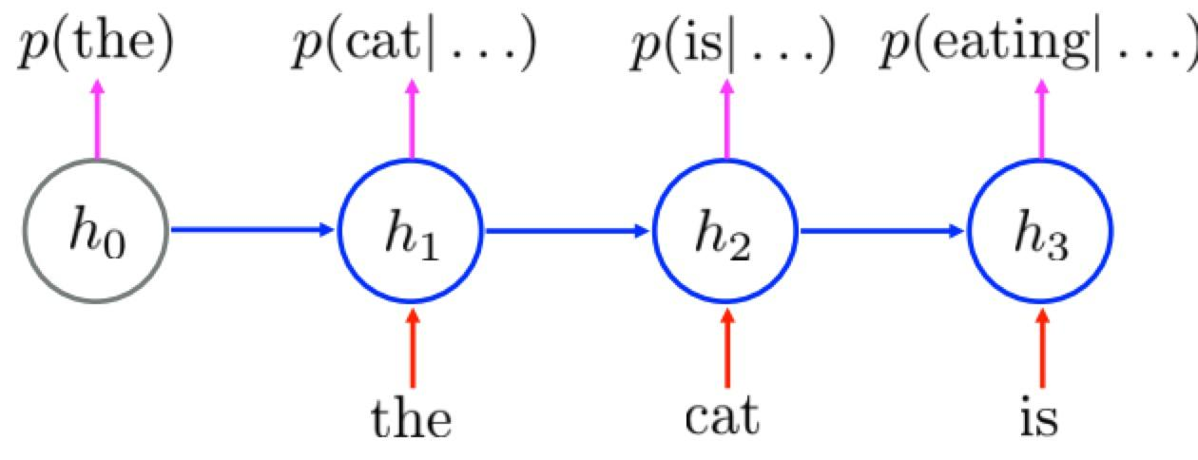
Chatbot
Traditional approaches:
Hand-craft knowledge base are used.
Can not address out-of-domain question.
Deep learning approaches:
Neural language models which can generate language.
Notes:
Need hand-desgined features to capture negation

Slide 35
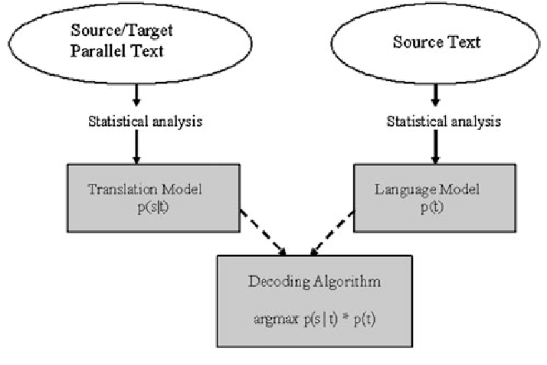
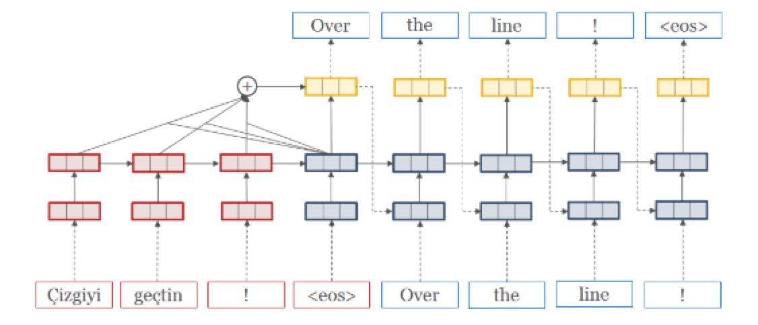
Machine Translation
Traditional approaches:
Statistical model (Moses)
Very large complex system
Deep learning approaches:
Source sentence is mapped to vector, then output sentence generated
Notes:
Figure from open nmt parallet

Slide 36
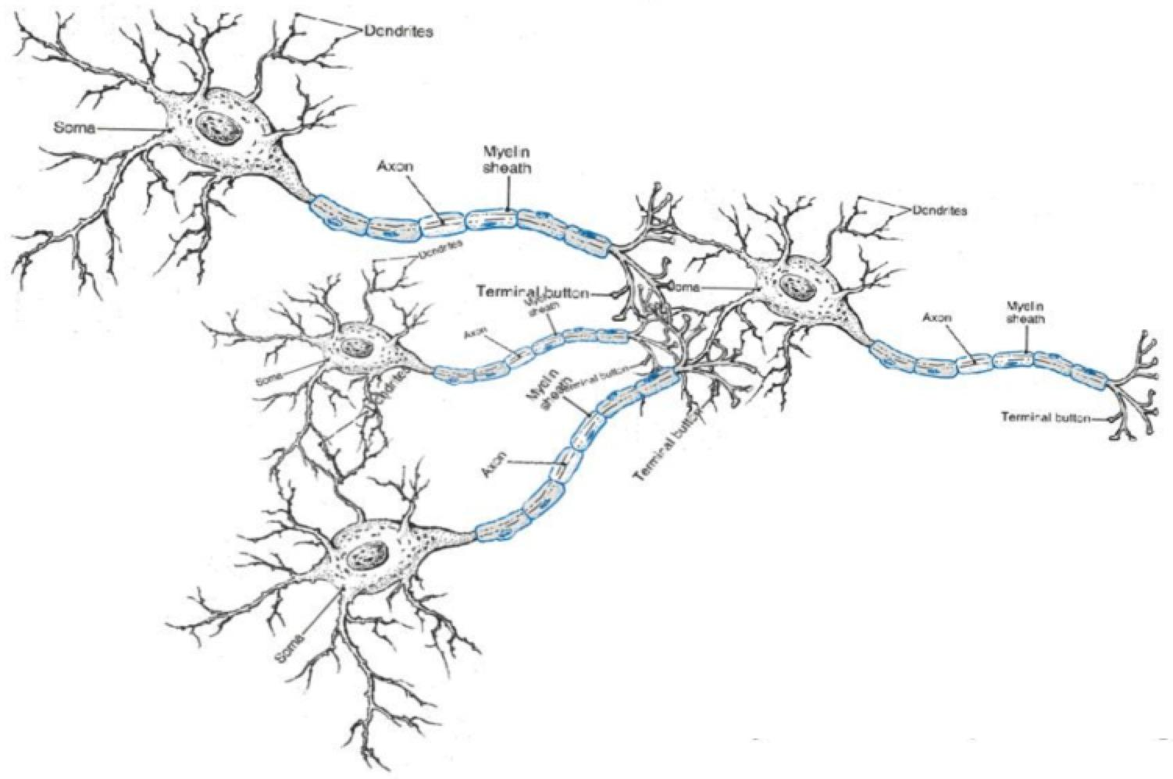
Neural Network
The term Neural network is that the models that simulate the functional properties of neurons in the brain.
Notes:
Figure from open nmt parallet

Slide 37
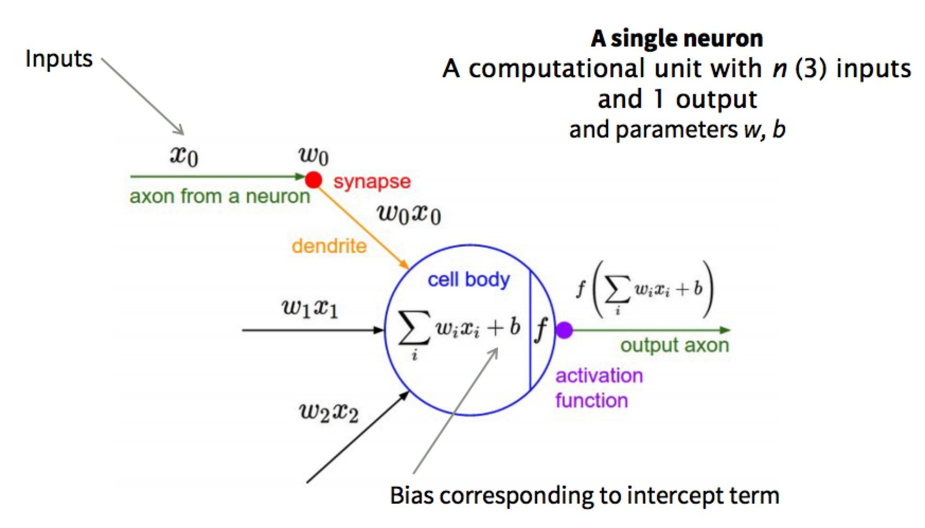
Neuron Computation: Logistic Regression
Equations in the artificial neuron
Logistic Regression is related to the basic operation of basic neuron, if the f is sigmoid function
Notes:
Figure from open nmt parallet

Slide 38
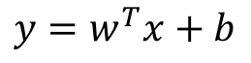
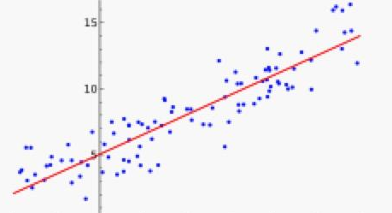
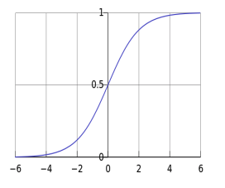
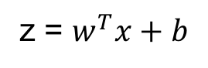
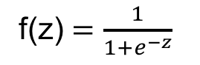
Logistic Regression
Logistic Regression was developed as a statistical model that is used to estimate the probability of a binary response based on one or more features.
A binary response: binary classification problem.
Linear Regression: model the linear relationship between a continuous target and several features.
If target y is binary variable (0 vs 1)
If we want the outcome can be interpreted from probabilistic aspect
Solution: fed the output of linear regression into sigmoid function
Notes:
In stattistical, a scala response dependent variable
Explanatory variables, independent variables

Slide 39
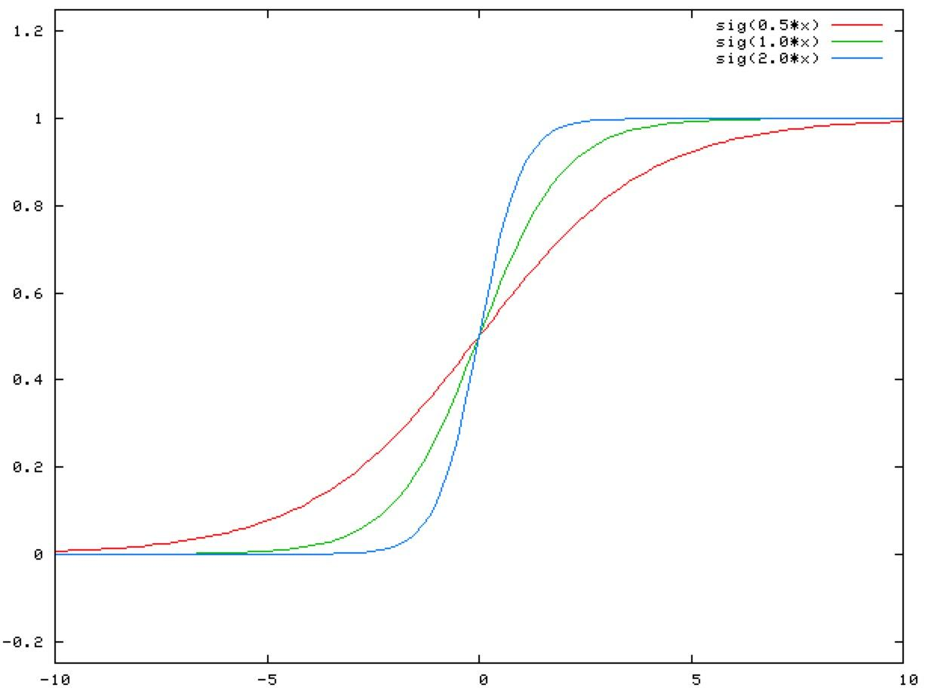
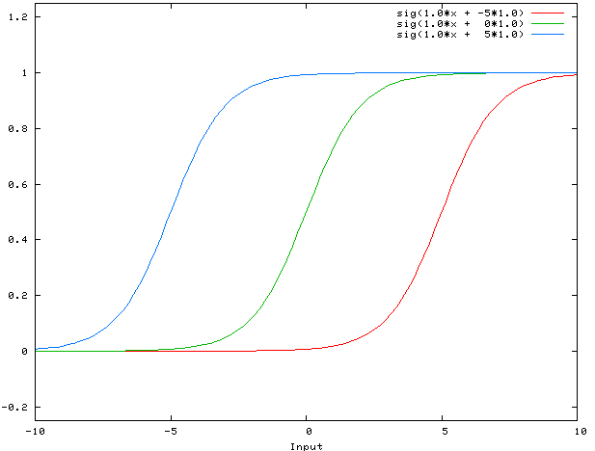
Why Bias Term?
Improve the model capacity
For linear regression, without b, the line always pass through the origin.
For logistic regression, the story is the same.
w only control the steepness of the sigmoid function
Bias term can shift the entire curve to the left or the right
A Small Trick:
We can put b in the features.
Notes:
In stattistical, a scala response dependent variable
Explanatory variables, independent variables

Slide 40
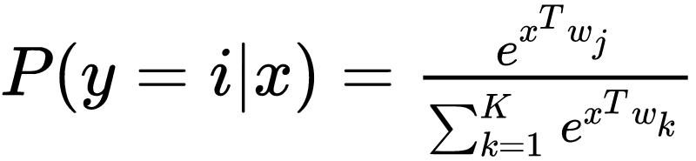
Softmax
A general case of LR for multiclass classification
Linear transformation is still used
Softmax function convert a K-dimensional vector of real values to a K-dimensional vector of prob. values
Apply a linear transformation defined by W to vectors x
Notes:
In stattistical, a scala response dependent variable
Explanatory variables, independent variables

Slide 41
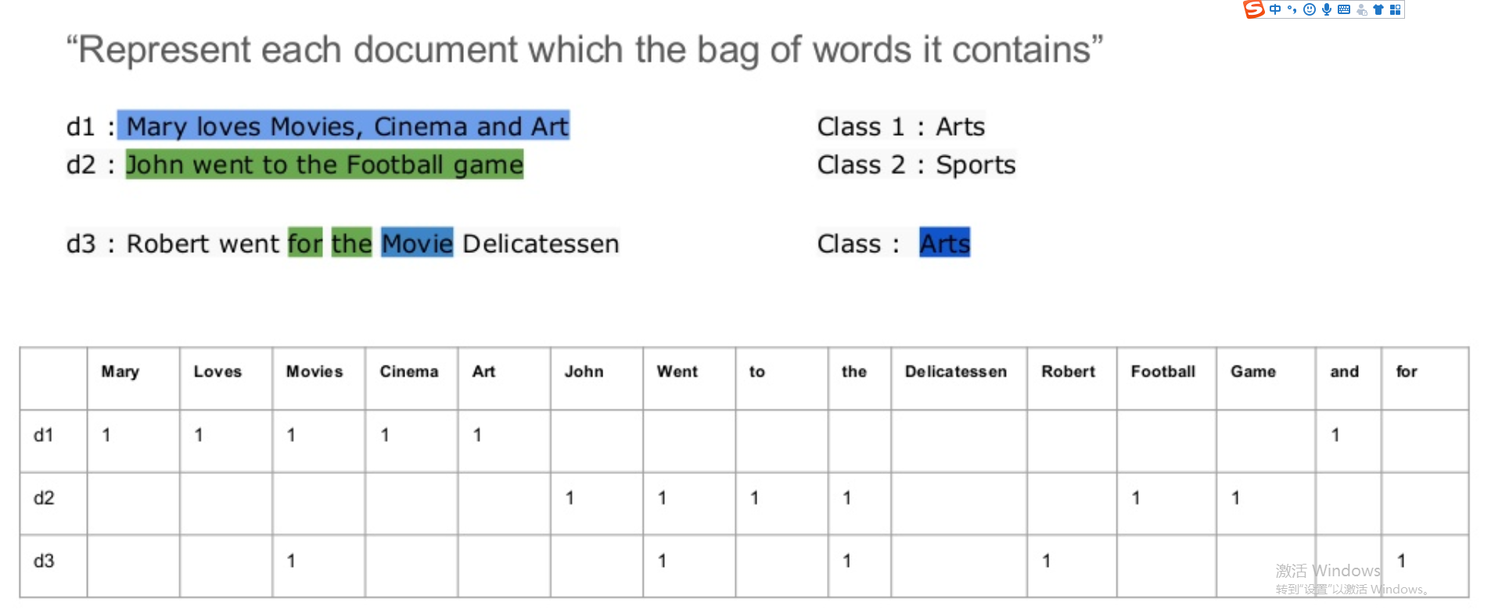
Bag of Words Models
Notes:
In stattistical, a scala response dependent variable
Explanatory variables, independent variables

Slide 42
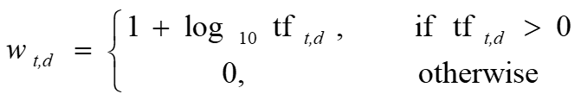
Bag of Words Models
The dimensionality of document vector is the vocab size
Feature values can be binary one: whether it contain the term
Feature values can be count of the term: TF - Model
Feature values can be Log-frequency weighting (smooth)
Notes:
In stattistical, a scala response dependent variable
Explanatory variables, independent variables

Slide 43
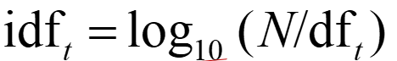
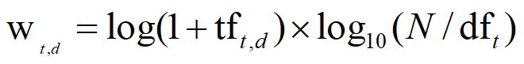
Term Frequency-Inverse Document Frequency Models
One logic: frequent terms are less informative than rare terms
Inverse document frequency of one word t
We used IDF combined with term frequency as feature value
Perform well for information retrieval: given a query, return similar items
Notes:
In stattistical, a scala response dependent variable
Explanatory variables, independent variables

Slide 44
BoW Model
This kind of vectors does not consider the ordering of words in document.
NLP is more challenging than CV and CV is more challenging than NLP
share the same vector
High-dimensionality and Sparse Vector Space

Slide 45
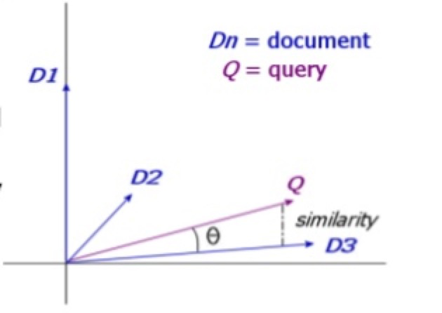
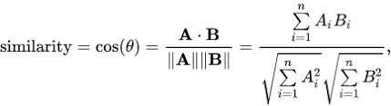
Information Retrieval
Given a query, return a similar document from the collections
The keys are: the representation of document and query and the definition of the relevance
Representation: TF-IDF
Relevance: cosine similarity

Slide 46
Text Classification/ Clustering
Via Bow Models, we can fed TF-IDF vectors into classification/clustering models.
SVM, LR, K-means and other ML models can be applied on top of BoW vectors
However, the curse of dimensionality…...

Slide 47
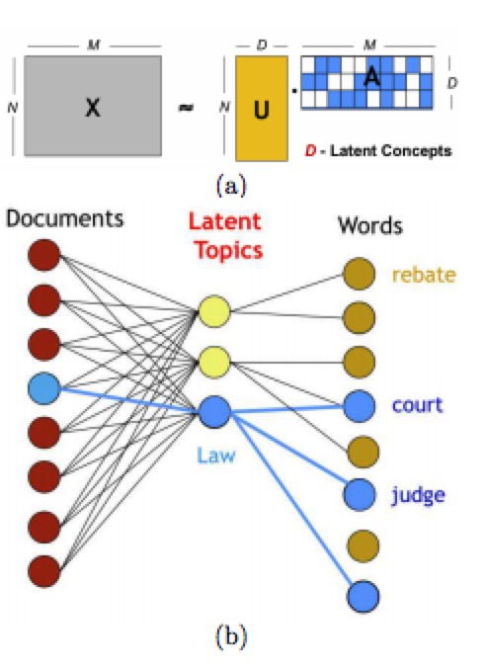
How to Improve BoW Features
Dimensionality Reduction:
It can make high-dimensional and sparse vector space into
low-dimensional and dense vector space.
Word Embedddings: to be continued
from Chen et.al

Slide 48
Summary
NLP achieves the interaction between computers and human languages;
ML = Representation + Loss/Target + Optimization;
Deep Learning is not a new idea;
Neural Network is closely related to Logistic Regression;
LR can address binary problem, while softmax model can solve multi-class problem;
Gradient descent algorithm can be used to optimize the LR and Softmax model
Next week, we will cover Neural Network in details

Slide 49
Reading List
Google AI Research Efforts in 2018:
https://ai.googleblog.com/2019/01/looking-back-at-googles-research.html
Deep learning for NLP: Overview of Recent Trends:
https://nlpoverview.com/index.html
Awesome Data Science with Python:
https://github.com/r0f1/datascience

Slide 50


